Slide 1
Ex 4.4 P247
There are four applications of determinant.
To calculate inverse of A.
To find the solution of Ax=b.
Volume of box
Pivots of a matrix

Slide 2




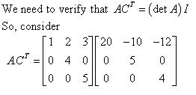
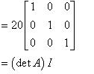
We know that when we multiply above result by A and then simplifying, we have
this is a triangular matrix so its determinant is equal to product of diagonal entries which is 20. Its all cofactors are
w which is the proof of first problem.

Slide 3
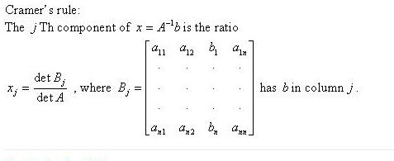
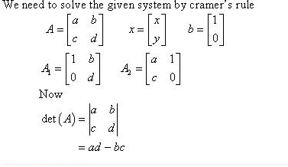
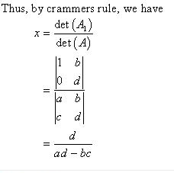
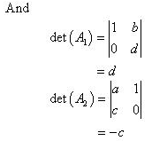
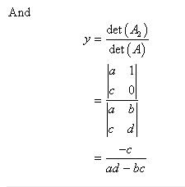
you have already studied about cramer rule, so solve all the problem by using cramer rule.
I

Slide 4
Question 4

Slide 5
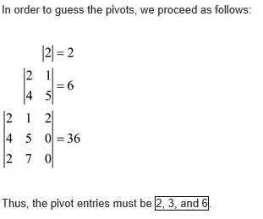
Problem 7
Pivots are entries which are are present on the diagonal diagonal when we reduce
the square matrix into
triangular matrix.

Slide 6
Problems 13-17
These problems are related to cramer rule, so I solve one problem in the start so do these problems by yourself and let me know if you face any difficuly.

Slide 7

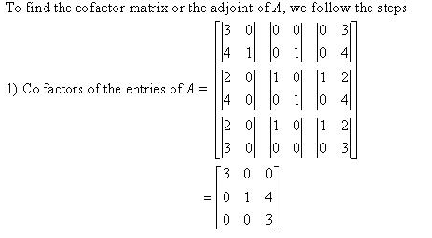
Problem 18
Solution:

Slide 8
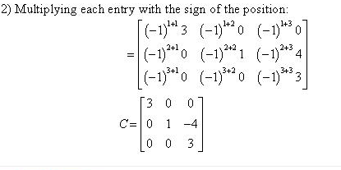
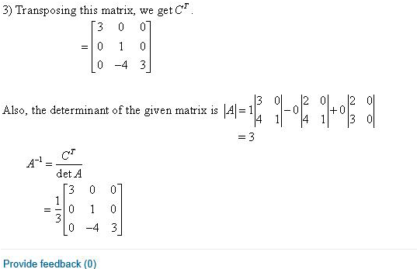

Slide 9
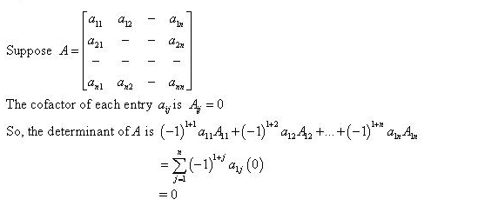

Problem 19

Slide 10
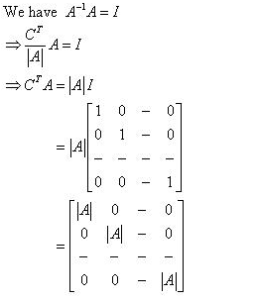

Problem 22

Slide 11
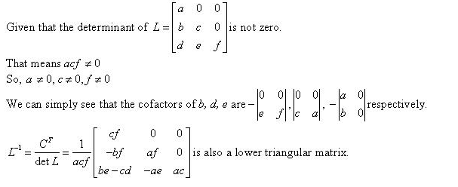
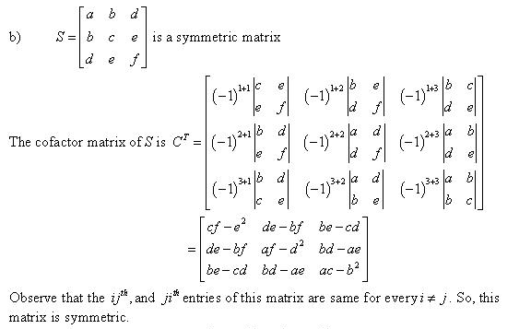
Problem 25

Slide 12
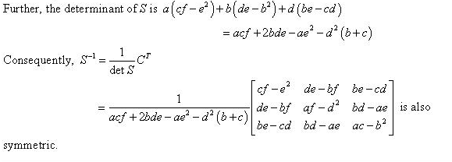

Slide 13


Problem 27

Slide 14
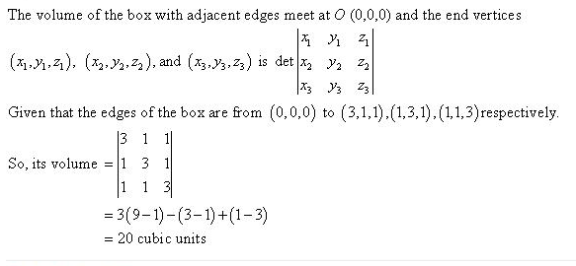
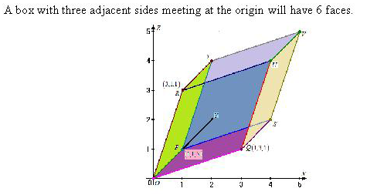
Problem 28

Slide 15
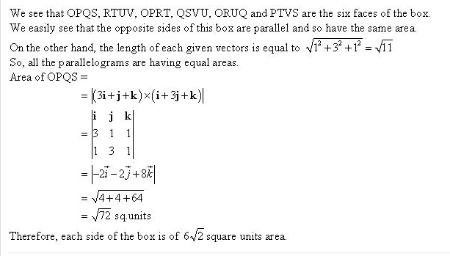

Slide 16
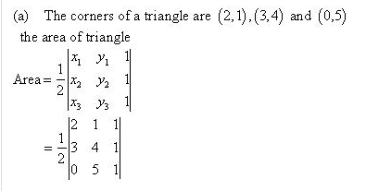
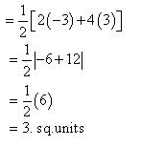
Problem 29

Slide 17



Problem 37

Slide 18

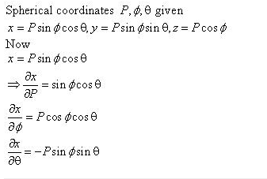
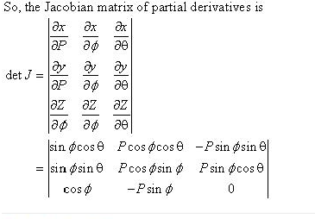
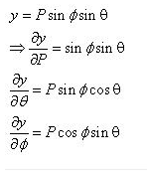
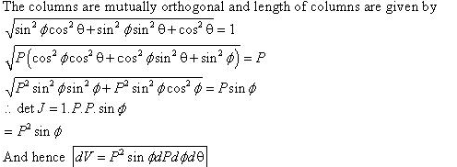

Problem 38

Slide 19

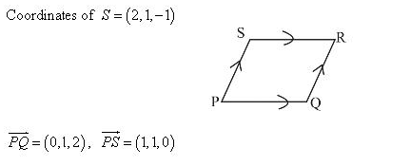
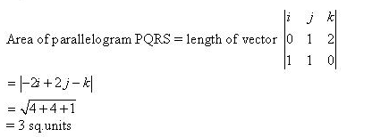
Problem 41

Slide 20
Question 43

Slide 21
Question 42

